Slide 2
Have Your Pi and Eat It Too: .NET Core on Raspberry Pi
Cam Soper
Microsoft

Slide 3
The Berry Beginning

Slide 4
Demo – Building, Deployment, and Debugging

Slide 5
Putting the “Things” in IoT

Slide 6
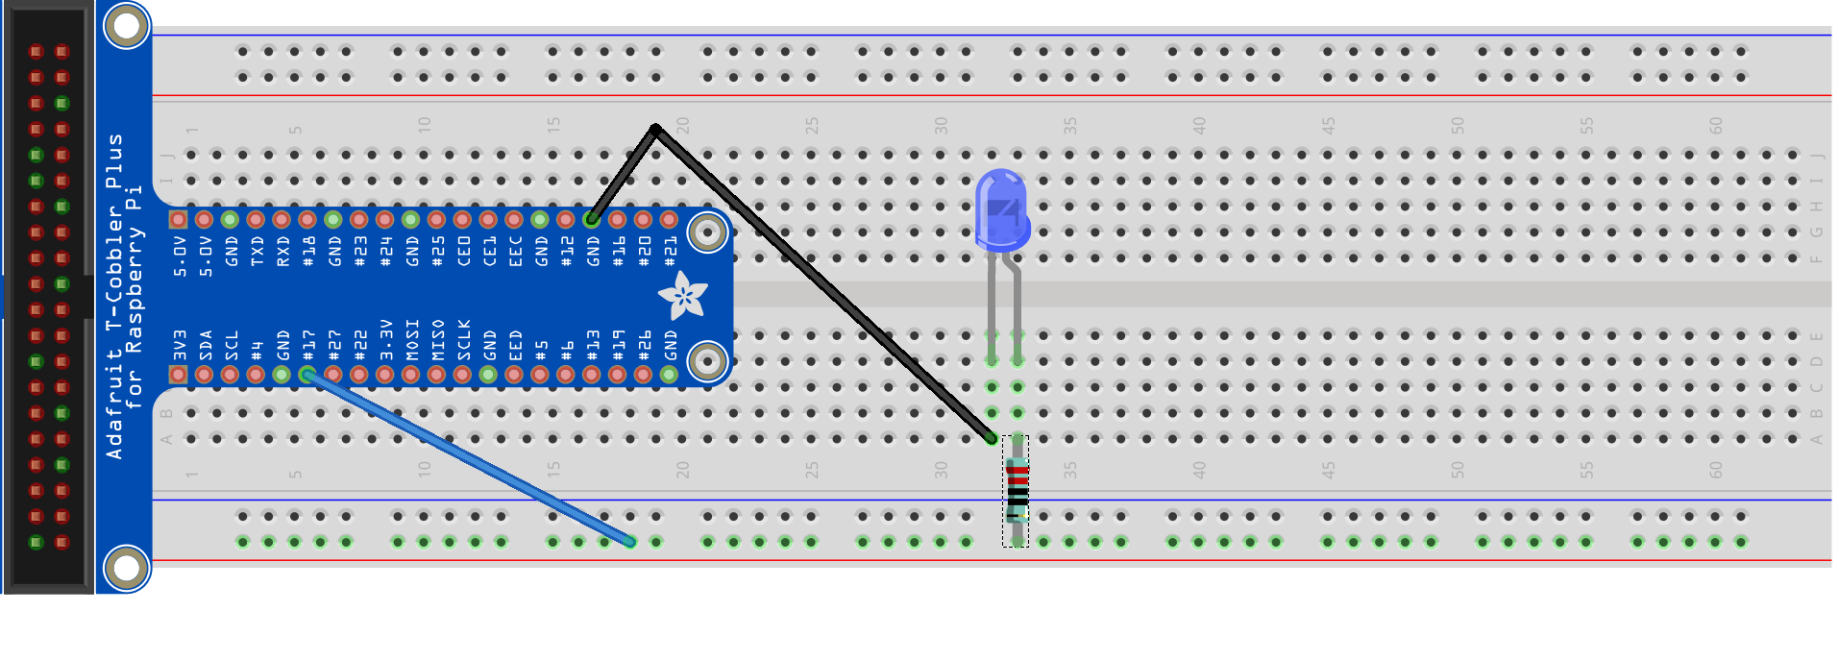
Hello World (LED)
Ground
GPIO 17

Slide 7
Demo - Hello World (LED)

Slide 8
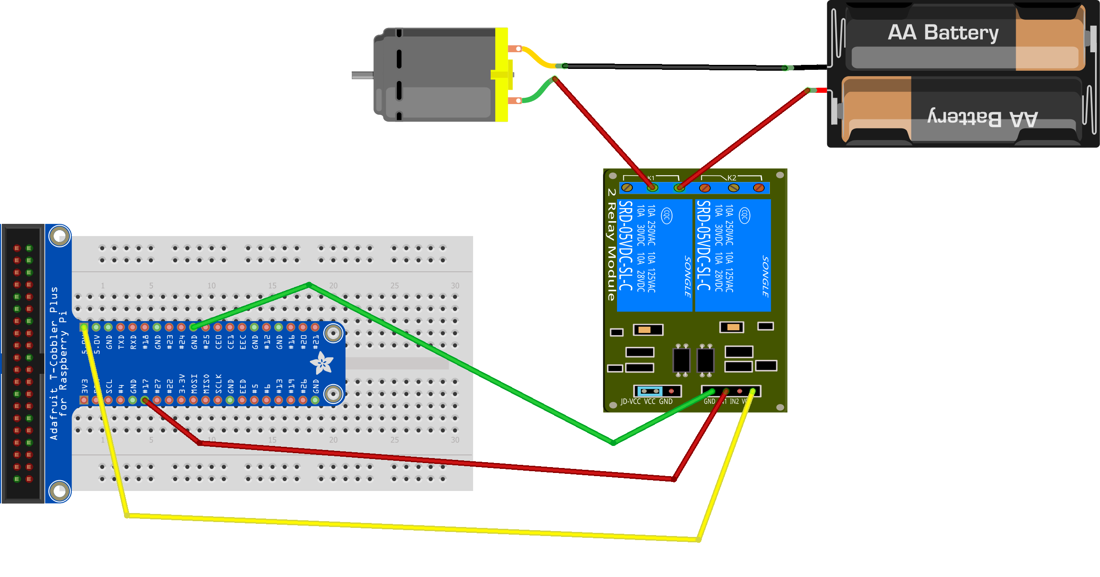
Hello World (Motor)
Ground
GPIO 17
5V

Slide 9
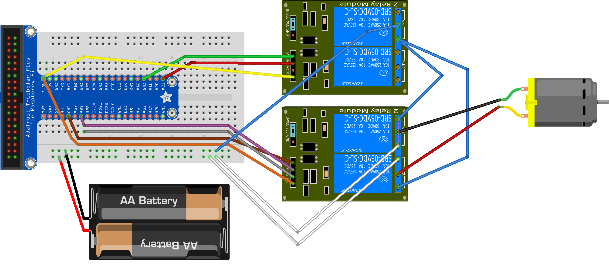



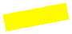








Reversible Motor
GPIO 21
Positive
Negative
Negative
Positive
GPIO 27

Slide 10
Demo - Motors

Slide 11
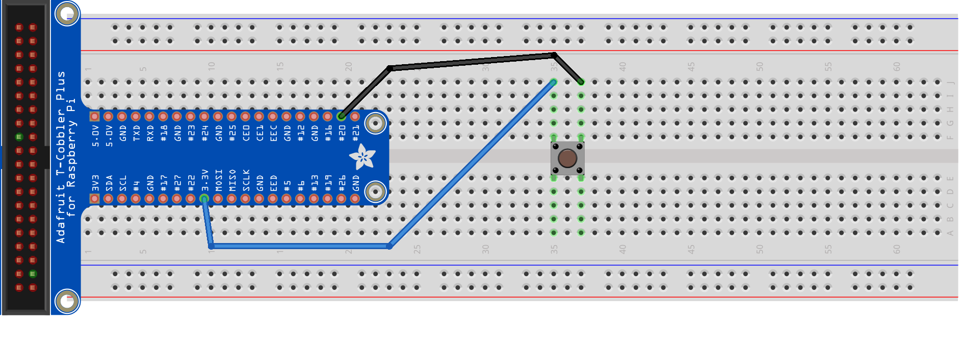
Push Button
GPIO 20
3.3 V

Slide 12
Demo – Push Button

Slide 13
What’s IoT without the Internet?

Slide 14
Demo – Door Sensor Alerts

Slide 15

Build Status Indicator

Slide 16
Demo – Build Status Indicator

Slide 17

Cortana Integration
Hey, Cortana…

Slide 18
Demo – Cortana

Slide 19
Next Steps – Go create something!

Slide 20
Questions?

Slide 21


Thank you! https://github.com/camsoper/have-your-pi @CamSoper CamSoper

